Slide 1
Sorin HeartLink – Perfusion Systems and Solutions
Christian Chlela
Senior Clinical Expert
Sorin Group

Slide 2
Steering Perfusion
Assessing the Adequacy of Perfusion:
Goal: To replace respiration and circulation
Intra Operative Assessment:
      Blood gases and hematology
      Circulation flow rates & pressures
      Adherence to standard/best practices and techniques
    Common “Steering” Parameters (Galletti, Berger, Reed, Taylor):
      Flow Index: 2.2 to 2.6 ml/min/m²
      SvO₂ > 65%
      PvO₂ > 40 mm Hg
      Lactate < 2 mmol/l
    But, M&M problems persist

Slide 3
Focal Points in Perfusion
10
9
8
7
%
6
5
4
3
2
1
0
< 18
18
19
20
21
22
23
24
25
26
27
28
> 28
Lowest HCT on CPB
Total N/100
% ARF-D
Cut off
Karkouti et al, Ann Thorac Surg 2003
3rd Perfusion Symposium Antalya, TURKEY 2015

Slide 4
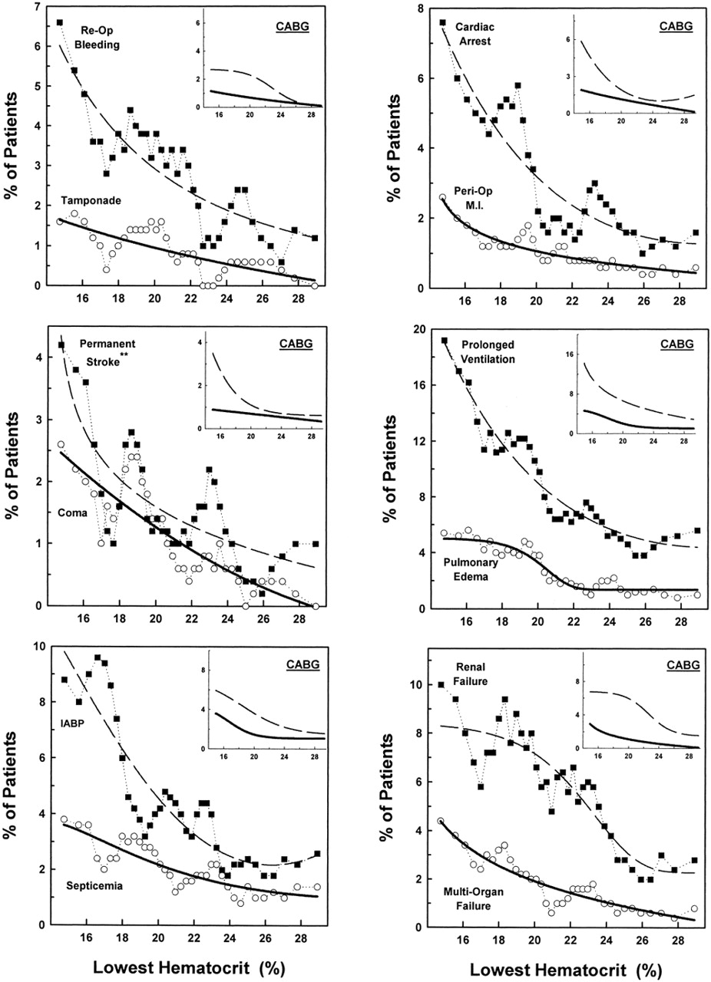
Habib et al, JTCVS 2003
Lowest HCT on CPB is associated to:
Reopening
Bleeding
Perioperative MI
Cardiac arrest
Stroke
Coma
Prolonged ventilation
IABP
Renal failure
MOF
3rd Perfusion Symposium Antalya, TURKEY 2015

Slide 5
Renal Complications from Cardiopulmonary Bypass
Acute Kidney Injury (AKI) :
  Occurs in 20-30% of patients undergoing CPB
    60 – 100K / yr in the US
    Estimate $1 billion to treat
  If dialysis is required:
    Up to 50% mortality
    Patients remain dialysis dependent

Slide 6
Common Perfusion Steering Parameters
Common “Steering” Parameters (Galletti, Berger, Reed, Taylor):
  Flow Index: 2.2 to 2.6 ml/min/m²
  SvO₂ > 65%
  PvO₂ > 40 mm Hg
  Lactate < 2 mmol/l
BSA only
Full systemic parameters: no regional information
Acute Anemia:
Reduced viscosity
Increased cardiac output
Perfusion Anemia:
Pump flow based on BSA
Result of extended anaerobic metabolism
3rd Perfusion Symposium Antalya, TURKEY 2015

Slide 7
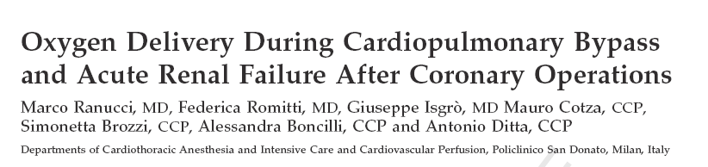

Reducing Kidney Injury Associated with CBP
Test premise that lowest Hct on CPB is risk factor for renal failure:
1048 pt study: Lowest Hct, Lowest O₂ delivery, Qb, transfusions
Best predictor of ARF/AKI was the lowest O2 delivery
High hemodilution is a risk factor for ARF/AKI:
  Reduced by increasing O₂ delivery and pump flow
  Critical O₂ delivery of 272 ml/min/m²: aerobic/anaerobic threshold
Kidney is sensitive to low O₂ delivery:
  Both O₂ content and flow rate
Cited by 32 articles available in literature
3rd Perfusion Symposium Antalya, TURKEY 2015

Slide 8
Acute Renal Failure and DO₂
Source: Ranucci et al, Oxygen Delivery During Cardiopulmonary Bypass and Acute Renal Failure After Coronary Operations,Ann Thorac Surg 2005,; 80; 2213-2220

Slide 9
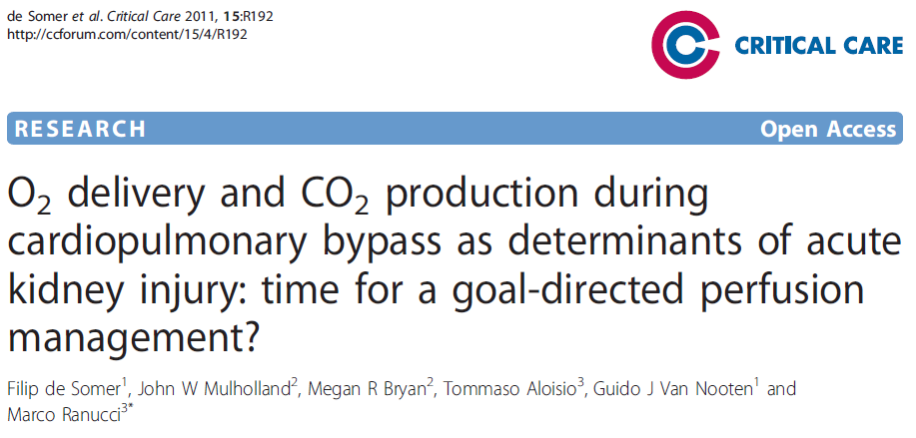
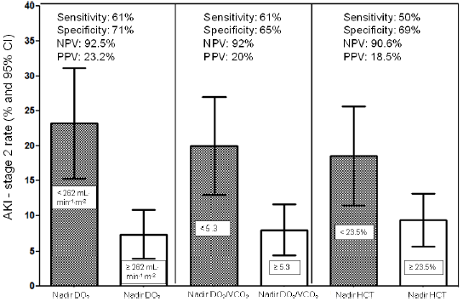
Nadir DO₂ Above Threshold Effectively Guides Therapy de Somer, et al. Time for GDP?
359 Cardiac surgery patients
DO₂ “modifiable risk factor” in preventing AKI
Nadir DO₂ above threshold effective guide to therapy
Nadir DO₂/VCO₂ further guides management

Slide 10


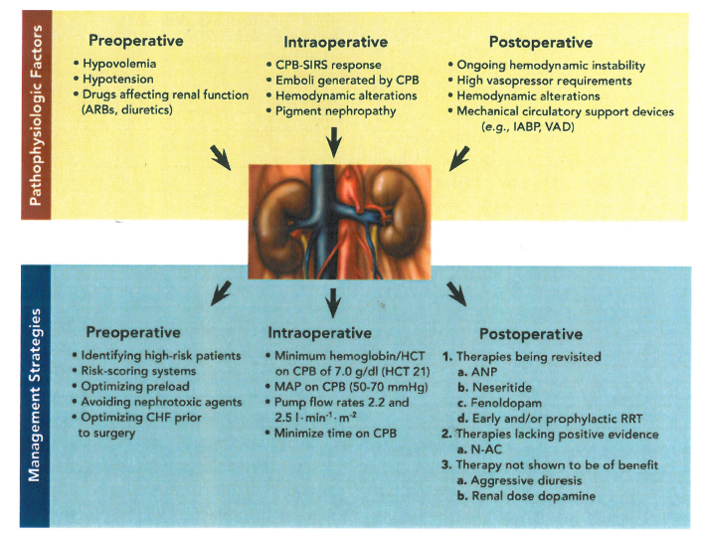
Factors and Management of AKI
Intraoperative Factors:
CPB-SIRS response
Emboli from CPB
Hemodynamic alterations
Intraoperative Strategies:
Min hemoglobin/Hct:
  7.0 g/dl / 21
MAP 50 – 70 mmHg
Flows: 2.2 – 2.5
Minimize CPB time

Slide 11
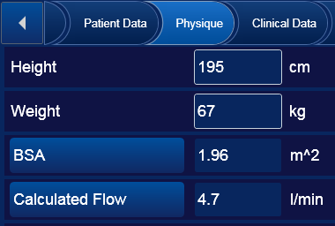
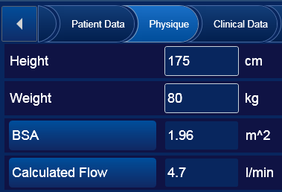
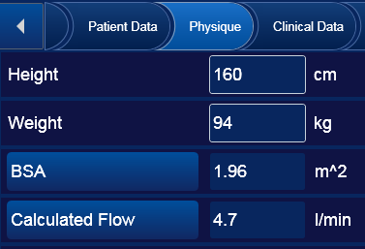
Standardized perfusion approach - Pump flow based on BSA
Patients with same BSA, but very different physical characteristics may receive the same pump flow
They might have different oxygen supply needs
Hct is not considered
While normally cardiac output adapts to Hct (e.g it increases in case of anemia)

Slide 12
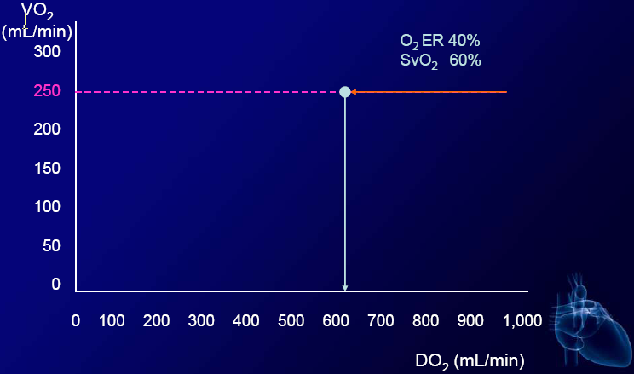
Respiration and Metabolic State

Slide 13
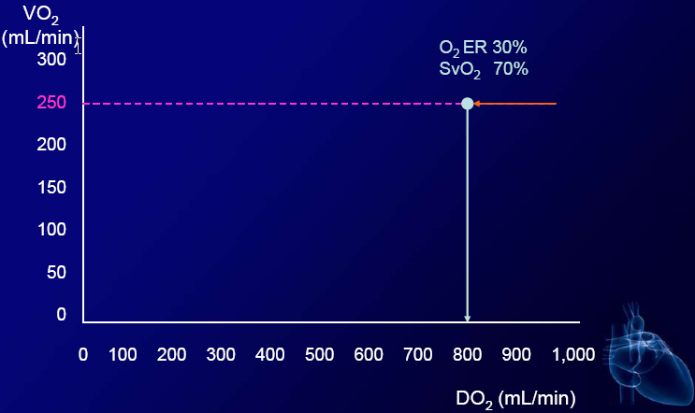
Respiration and Metabolic State

Slide 14
Respiration and Metabolic State

Slide 15
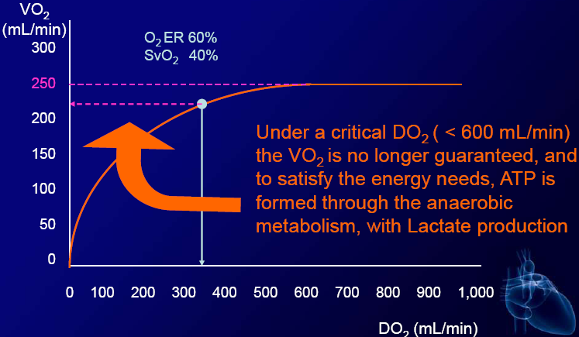
Respiration and Metabolic State

Slide 16
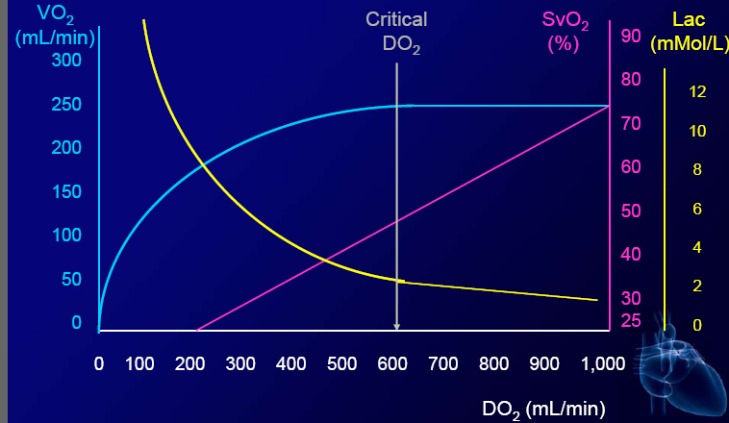
Respiration and Metabolic State

Slide 17
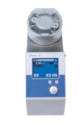

GDP MonitorTM: Oxygen Delivery DO2
DO₂ is the amount of oxygen delivered to the whole body from the lungs/oxygenator.
Indexed DO₂
DO_{2i}> 262 mL/min/m²
DO_{2i}
Real-time assessment of adequacy of flow and hematocrit
3rd Perfusion Symposium Antalya, TURKEY 2015

Slide 18

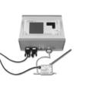

GDP MonitorTM: Carbon Dioxide Production VCO2
VCO₂ is the amount of carbon dioxide produced by the tissues, measured as the amount of carbon dioxide given off by the oxygenator :
Capnograph
DO2i/VCO2i> 5
VCO₂
Predictor of lactate metabolism
3rd Perfusion Symposium Antalya, TURKEY 2015

Slide 19
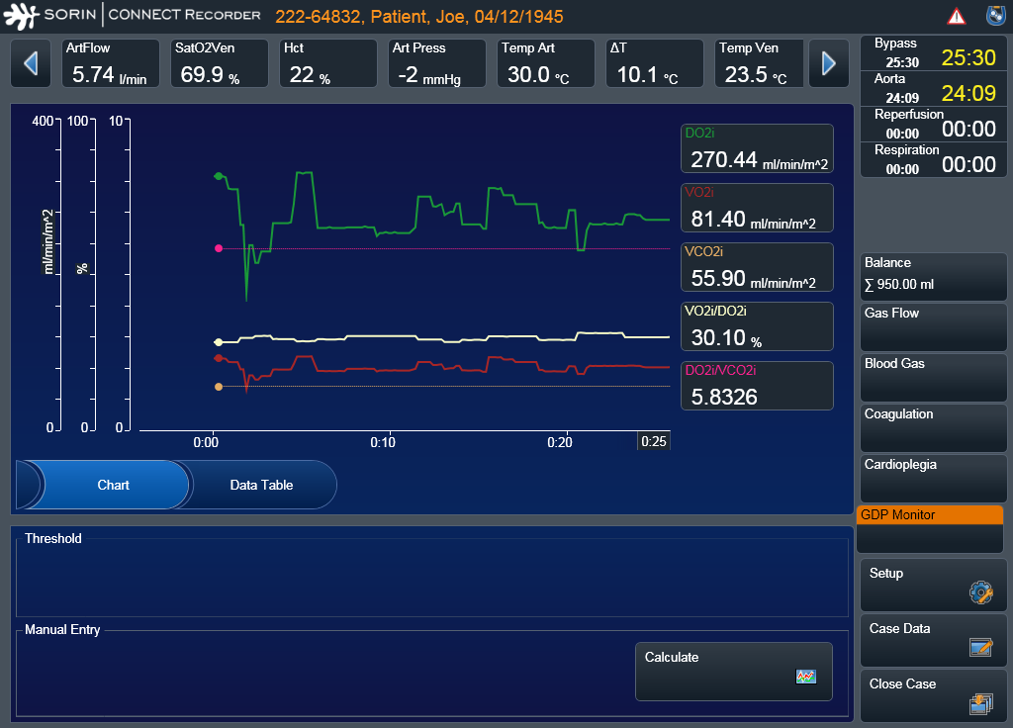
GDP Monitor TM allows to monitor real time the key patient metabolic parameters during CPB

Slide 20
Effect of GDP on kidney injury
Goal Directed Perfusion (GDP)
  Reduces post operative creatinine increase
  Reduced AKI rate from 25 % to 9 %
Low hemoglobin patients
  Significantly reduces creatinine increase in patients that require a transfusion
  Reduces new AKI in small, anemic patients

Slide 21
Effect of Sorin Inspire and Goal Directed Perfusion (GDP) on PRBC Transfusion
Baseline PRBC Transfusion Rate
  46%
  Volume mean 2.8 units
End of August 2014 PRBC Rate
  23%
  Volume mean 0.63 units
50% reduction in frequency of PRBC
77% reduction in volume of PRBC units

Slide 22

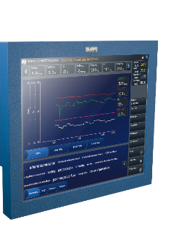

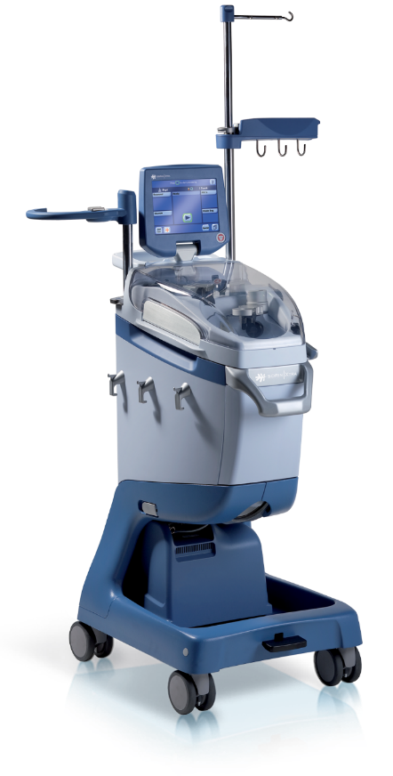



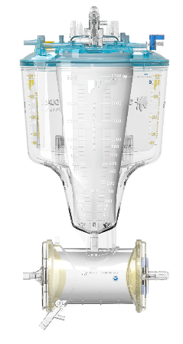

Sorin HeartLink
One System, Many Solutions

Slide 23
THANK YOU FOR YOUR TIME.
Questions ?
3rd Perfusion Symposium Antalya, TURKEY 2015

