Slide 1
Impact of Hemodilution in Adult Cardiopulmonary Bypass
Gerard J Myers RT, CCP Emeritus
Eastern Perfusion International
Dartmouth, Nova Scotia, Canada
3rd Perfusion Symposium
November 6-8, 2015
Antalya, Turkey

Slide 2
CARDIAC SURGERY HEMODILUTION PUZZLE
Recognition of
Preoperative
Anemia
Transfusion
Triggers
Prebypass Anesthesia
Fluid Management
Extracorporeal Circuit
Priming Volume
Intraoperative Perfusion
Fluid Management
Intraoperative Anesthesia
Fluid Management
Point of Care
Analyzers for Hgb/Hct
Surgery
and
Surgical Hemostasis
ICU Staff
Fluid Management
Protocols

Slide 3
First use bloodless prime in 1959 (Neptune et al)
Both then and now;
The goal of Hemodilution is to …
lower blood viscosity
improve organ perfusion
reduce hemolysis
improve blood/tissue temperature control
reduce use of banked blood
improve patient outcomes

Slide 4
However, we now know that Excessive Hemodilution leads to or contributes to …
Peripheral and organ edema
Acute kidney injury
Increased post operative bleeding
Increased need for banked blood/products
Increased incidence of stroke
Poor patient outcomes
Ranucci M: Ann Thorac Surg 2015; 100(1): 95-100
Karkouti K et al: J Thorac Cardiovasc Surg 2005; Feb;129(2):391-400
Habib RH et al: J Thorac Cardiovasc Surg 2003 Jun;125(6):1438-50

Slide 5
ExtraCorporeal Circuit (ECC) components that make up the total priming volume
Oxygenator prime volume
Arterial Filter prime volume
Arterio-Venous loop (A-V Loop) prime volume

Slide 6
Traditional way perfusionists compare adult oxygenator prime volumes
351
335
284
260
260

Slide 7
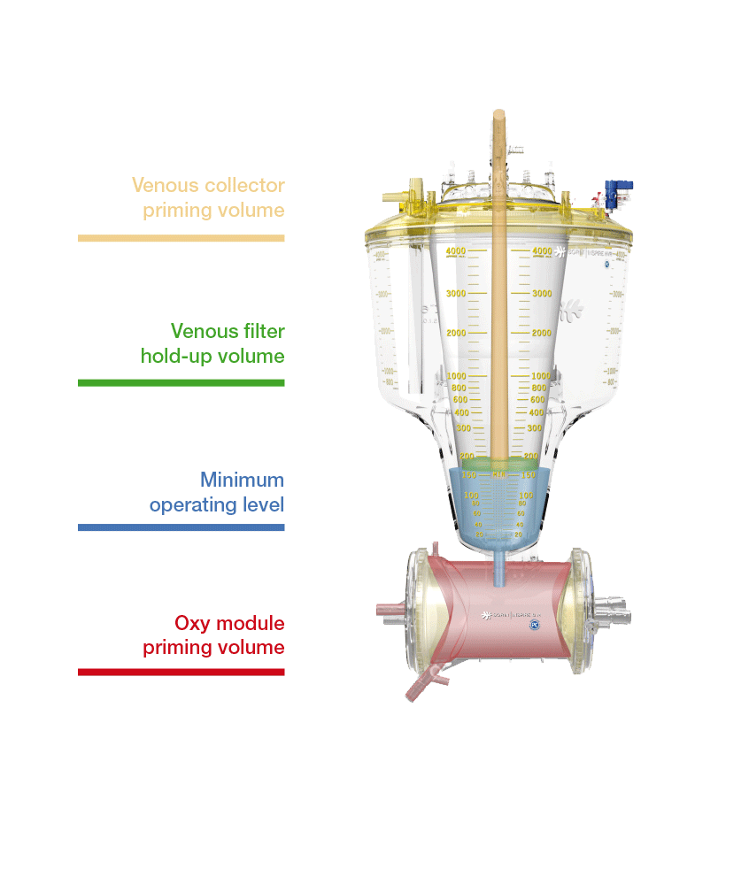
Dynamic Operating Volume
Arterial Filter Volume

Slide 8
Dynamic Operating Volume of Oxygenator

Slide 9
D.O.V + AV Loop =
Total ECC prime

Slide 10
Excessive Hemodilution is an independent risk factor for morbidity and transfusion
… it is a manageable risk factor
if addressed with evidence based transfusion triggers, appropriate clinical techniques and equipment, common sense, blood management programs
… Most important ..
Is the need for cooperation between all professions involved with perioperative cardiac surgery

Slide 11
5 Ways to Address Hemodilution
… in addition to reducing DOV
Recognize/treat preoperative anemia
Eliminate prebypass anaesthesia volume loading
RAP and/or VAP all on pump cases
Smaller (1.0 ml) syringes/less sampling for lab work
Recognize that Cardioplegia is a hemodilution factor

Slide 12
TEŞEKKÜRLER

